Slide 1

Implementing a message passing architecture using the SNS and SQS services (provided by AWS) – Order processing
Matei Stefan Madalin SCPD-1A

Slide 2
What do we want to do?
Emulate a shop’s order processing system
We receive a document with the buyer’s email and we confirm their order has been processed

Slide 3
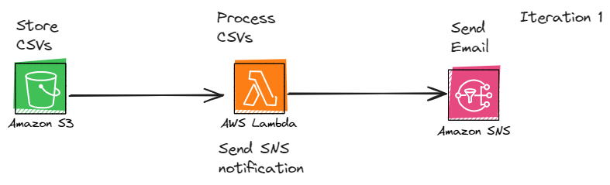
Arhitecture

Slide 4
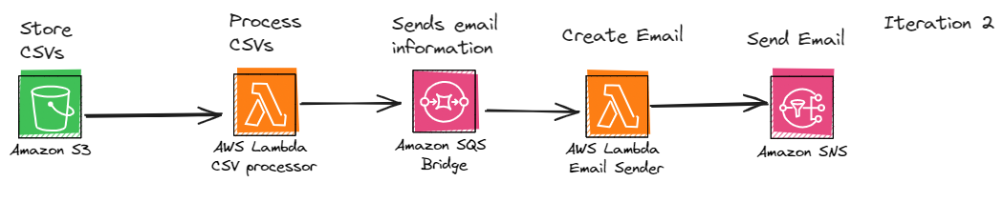
Arhitecture

Slide 5
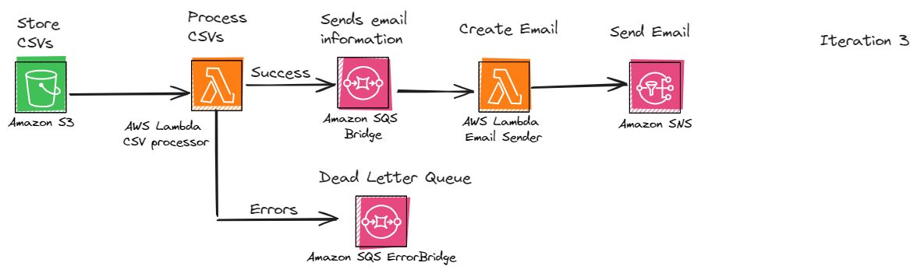
Arhitecture

Slide 6
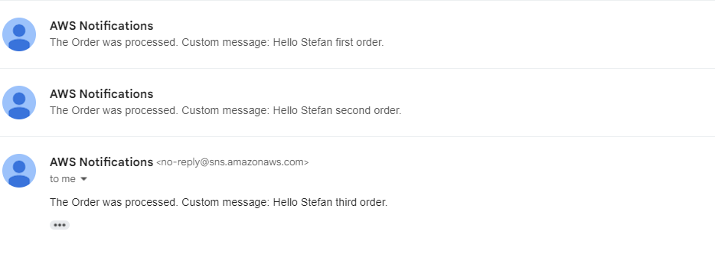
Results – Order processed

Slide 7
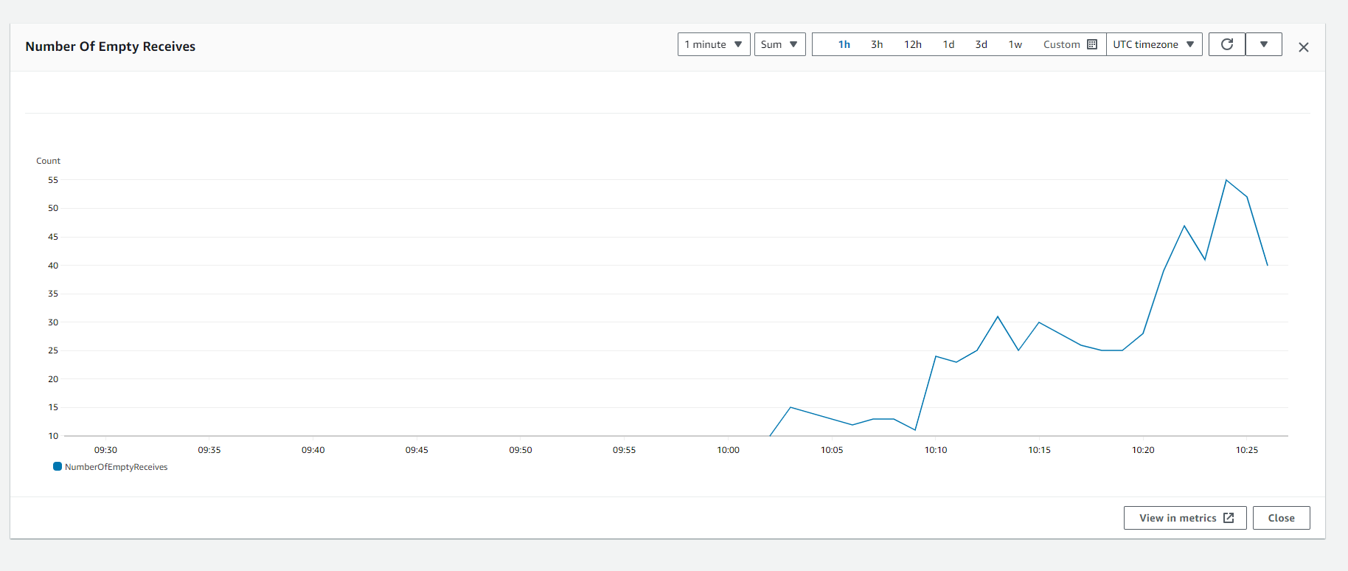
Results – Dead letter queue

